Slide 1
More About OVB

Slide 2
Our Basic In-Class Example
Our cases with cakes looked like this:
When we estimated a naïve, bivariate regression, we got a very different result than when we estimated a multiple regression.
 | One-Layer Cake | Two-Layer Cake
Two Cups of frosting | $16, $16 | $16, $16, $16, $16, $16, $16
One Cup of frosting | $10, $10, $10, $10, $10, $10 | $10, $10

Slide 3
Our Basic In-Class Example
Bivariate regression:
(Cake Price) = 8.5 + 3(Number of Layers)
Multiple regression:
(Cake Price) = 4 + 0(Number of Layers) + 6(Cups of Frosting)
Why did the coefficient on “Number of Layers” change?

Slide 4
Our Basic In-Class Example
Customers really value frosting, but don’t care about layers.
Cakes with more layers also happened to have more frosting on them – these two variables were correlated.
When we omitted Frosting, Excel told us that the price went up when Layers went up. But this was only due to (2): when layers increased, so did frosting (the important – and missing – factor) AND frosting had an effect on the price

Slide 5
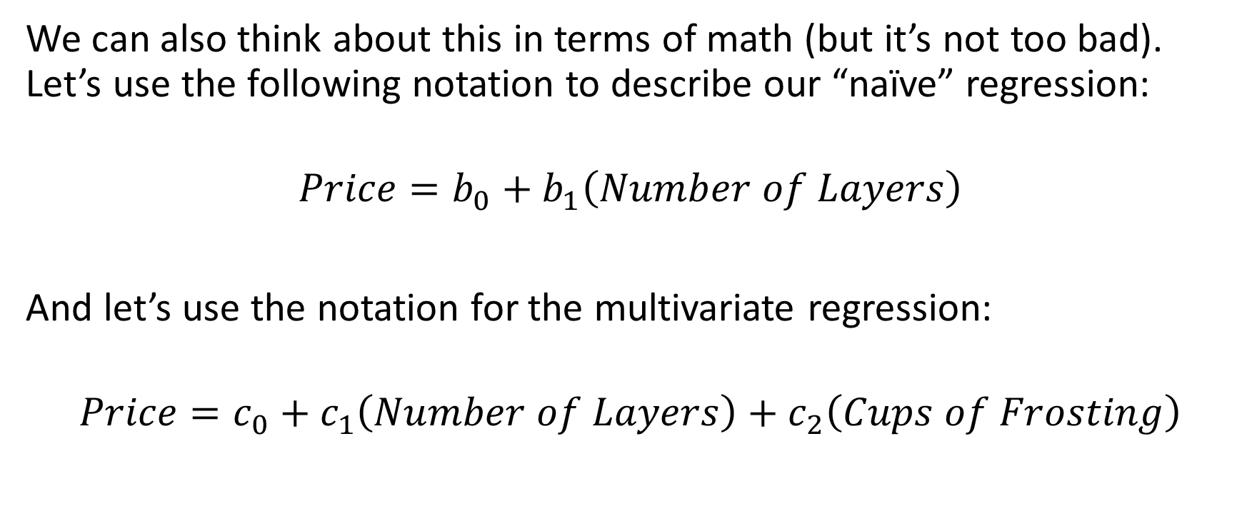
Our Basic In-Class Example
We can also think about this in terms of math (but it’s not too bad). Let’s use the following notation to describe our “naïve” regression:
$$Price=b_{0}+b_{1}\left(Number of Layers\right)$$
And let’s use the notation for the multivariate regression:
$$Price=c_{0}+c_{1}\left(Number of Layers\right)+c_{2}\left(Cups of Frosting\right)$$

Slide 6
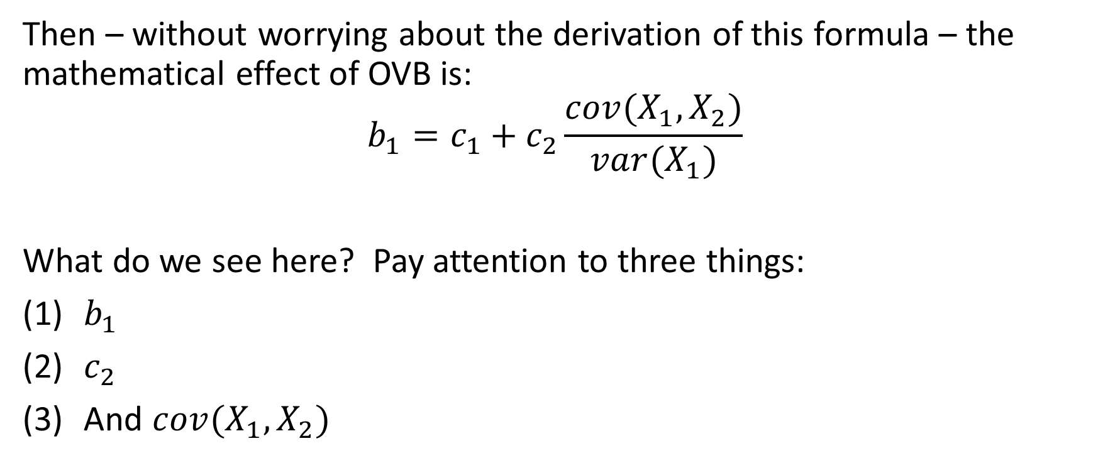
Our Basic In-Class Example
Then – without worrying about the derivation of this formula – the mathematical effect of OVB is:
$$b_{1}=c_{1}+c_{2}\frac{cov(X_{1},X_{2})}{var(X_{1})}$$
What do we see here? Pay attention to three things:
$b_{1}$
$c_{2}$
And $cov(X_{1},X_{2})$

Slide 7
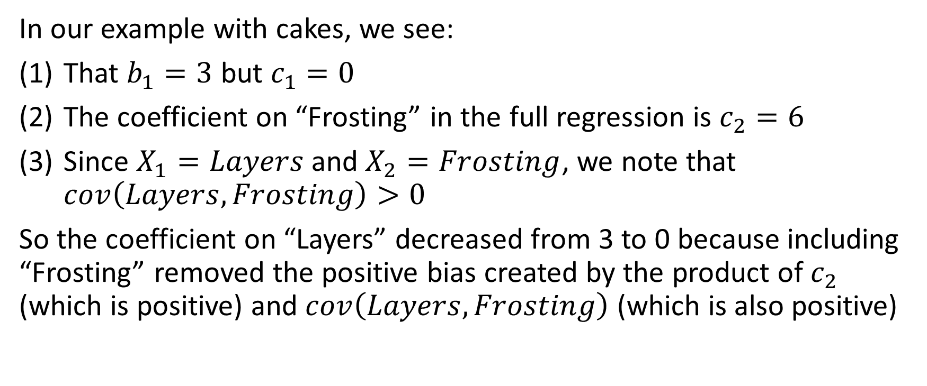
Our Basic In-Class Example
In our example with cakes, we see:
That $b_{1}=3$ but $c_{1}=0$
The coefficient on “Frosting” in the full regression is $c_{2}=6$
Since $X_{1}=Layers$and $X_{2}=Frosting$, we note that $cov\left(Layers,Frosting\right)>0$
So the coefficient on “Layers” decreased from 3 to 0 because including “Frosting” removed the positive bias created by the product of $c_{2}$ (which is positive) and $cov\left(Layers,Frosting\right)$ (which is also positive)

Slide 8
Other examples of OVB
What this tells us is that anytime we leave something out of our regression that is correlated with a variable in our regression, then we’re going to get an incorrect answer.
But what are some other examples of this problem?

Slide 9
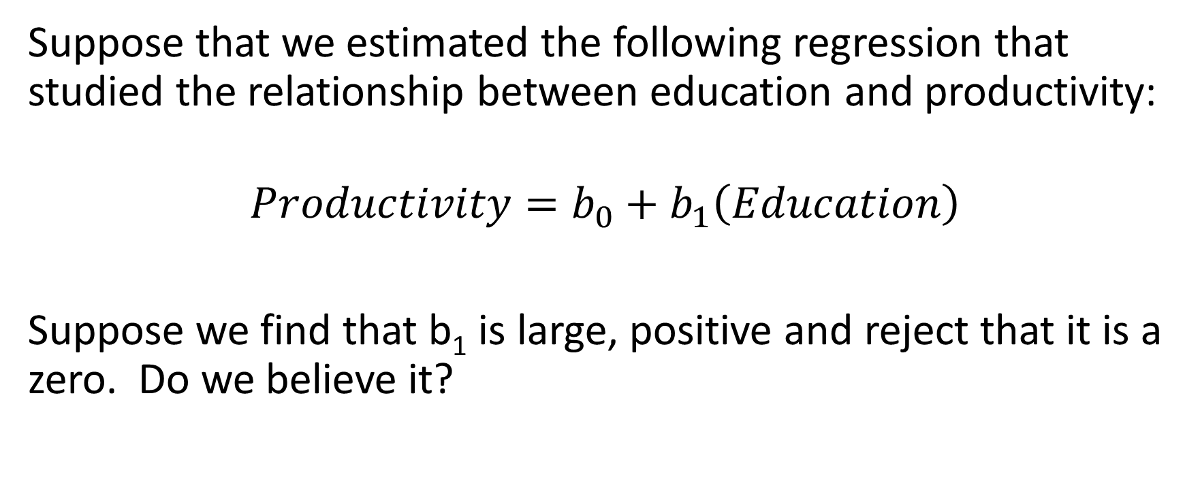
Example #1
Suppose that we estimated the following regression that studied the relationship between education and productivity:
$$Productivity=b_{0}+b_{1}\left(Education\right)$$
Suppose we find that b₁ is large, positive and reject that it is a zero. Do we believe it?

Slide 10
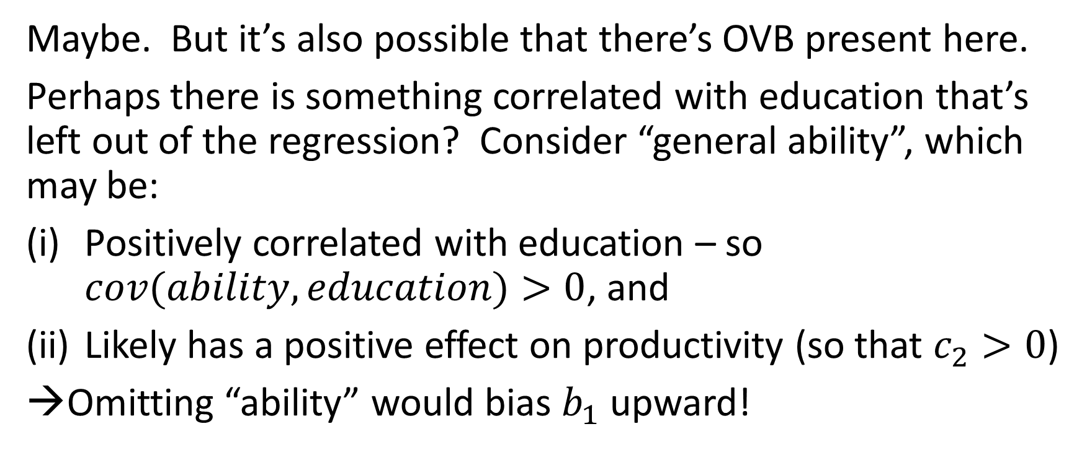
Example #1
Maybe. But it’s also possible that there’s OVB present here.
Perhaps there is something correlated with education that’s left out of the regression? Consider “general ability”, which may be:
Positively correlated with education – so $cov(ability,education)>0$, and
Likely has a positive effect on productivity (so that $c_{2}>0$)
→Omitting “ability” would bias $b_{1}$ upward!

Slide 11
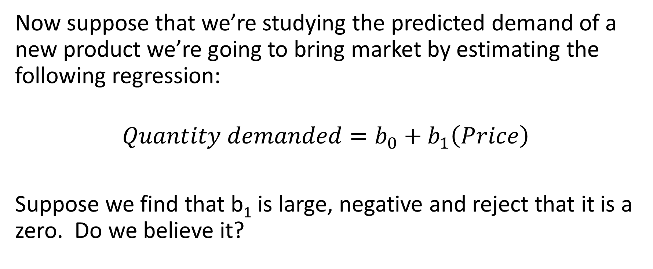
Example #2
Now suppose that we’re studying the predicted demand of a new product we’re going to bring market by estimating the following regression:
$$Quantity demanded=b_{0}+b_{1}\left(Price\right)$$
Suppose we find that b₁ is large, negative and reject that it is a zero. Do we believe it?

Slide 12
Example #2
Maybe. But perhaps there is something correlated with price that’s left out of the regression? Consider the number of competitors who produce this same good. It’s possible that:
Number of competitors is negatively correlated with price, since the larger the number of substitute goods in the market, the lower the price
Number of competitors may also be positively correlated with quantity demanded – larger markets attract more firms

Slide 13
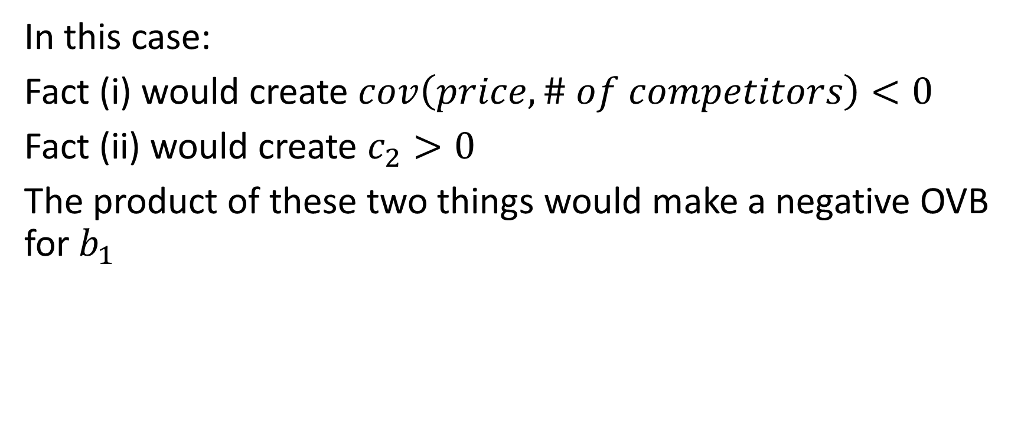
Example #2
In this case:
Fact (i) would create $cov\left(price,\# of competitors\right)<0$
Fact (ii) would create $c_{2}>0$
The product of these two things would make a negative OVB for $b_{1}$

Slide 14
Big points
Always be suspicious about the possibility of OVB.
When you see a problem set question or exam question that involves the addition of a new variable to a regression that changes the coefficient on a different variable, then ask yourself: (i) how are the two variables correlated, and (ii) what’s the coefficient on the new variable? The product of (i) and (ii) will give you insight into the OVB that is present.

